Slide 1
CAMELIA
The perfect Tool for tracking study

Slide 2

About me…
Created by Ana Massielle Coti Rodas on 2023
Currently on 3rd year of Computer Science
Quetzaltenango, Guatemala
CAMELIA was created in orden to satisfice my own problem of traking my personal sessions of study

Slide 3
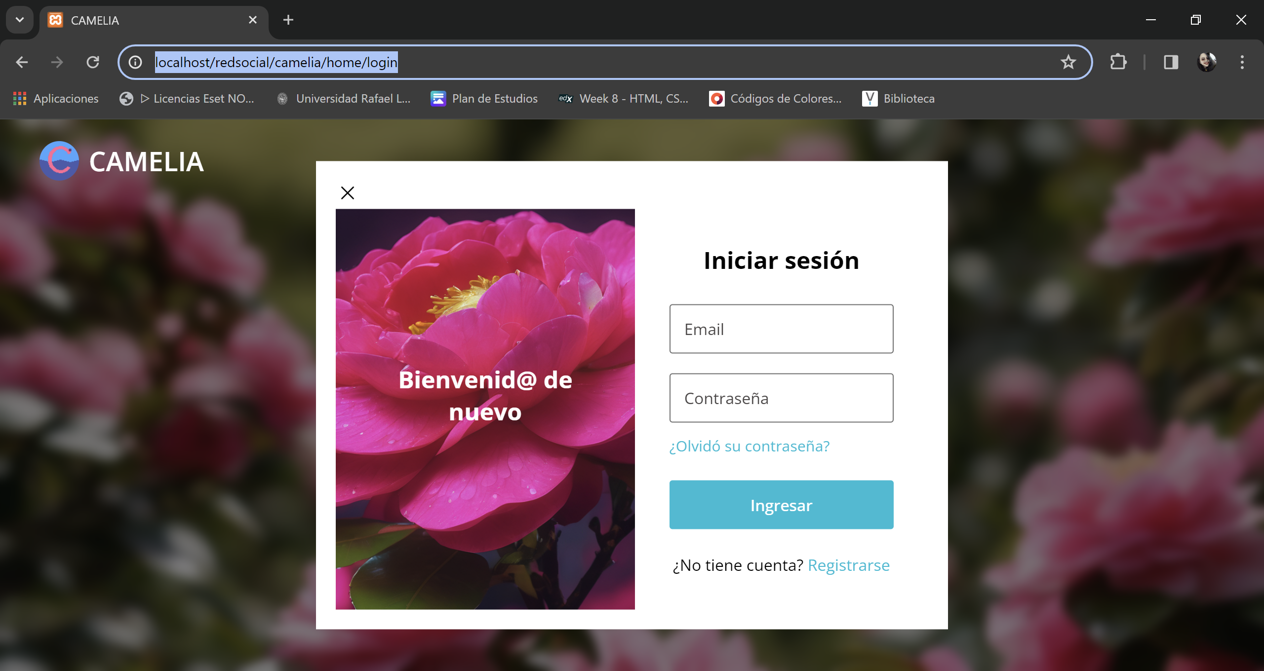
LOGIN

Slide 4
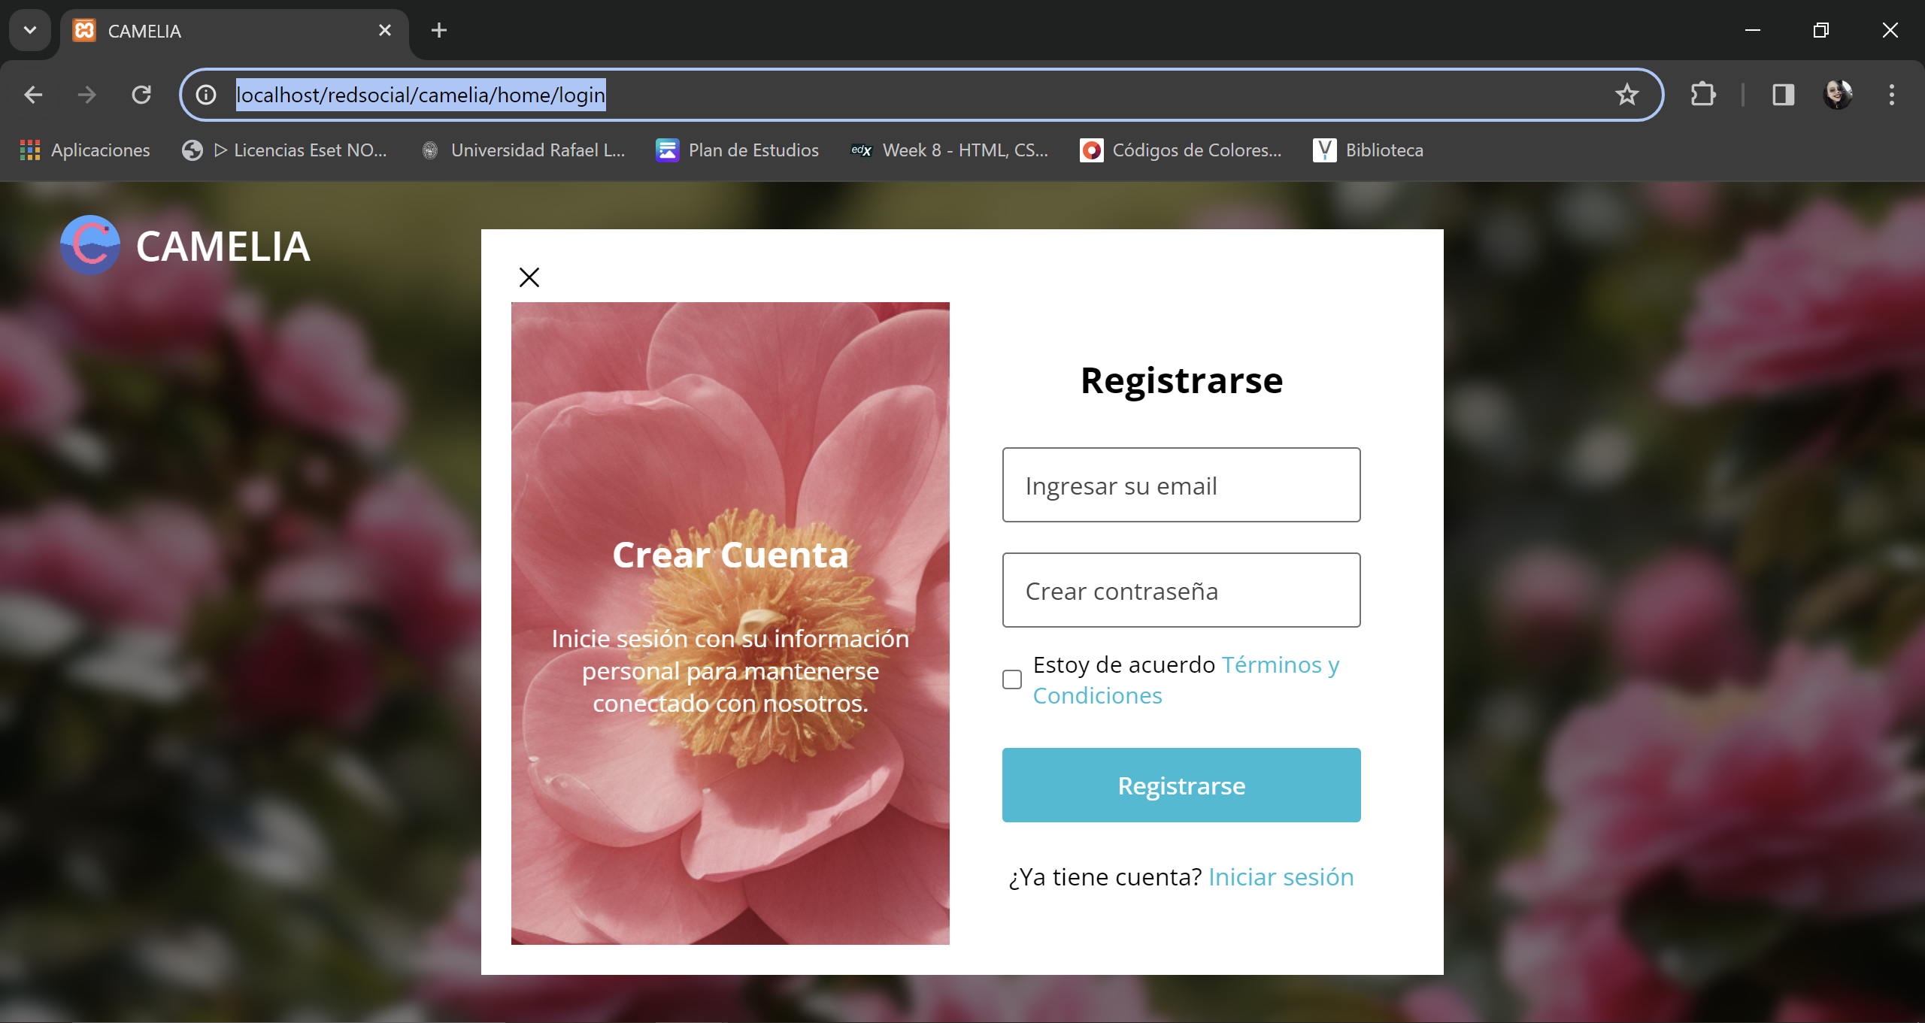
REGISTER

Slide 5
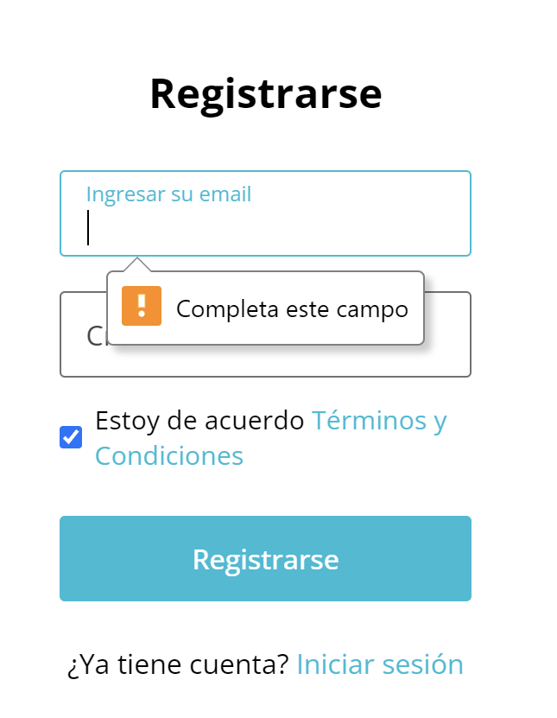
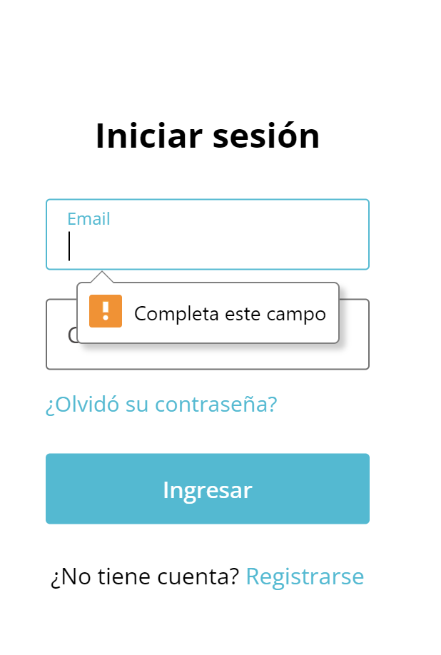
ERRORS

Slide 6

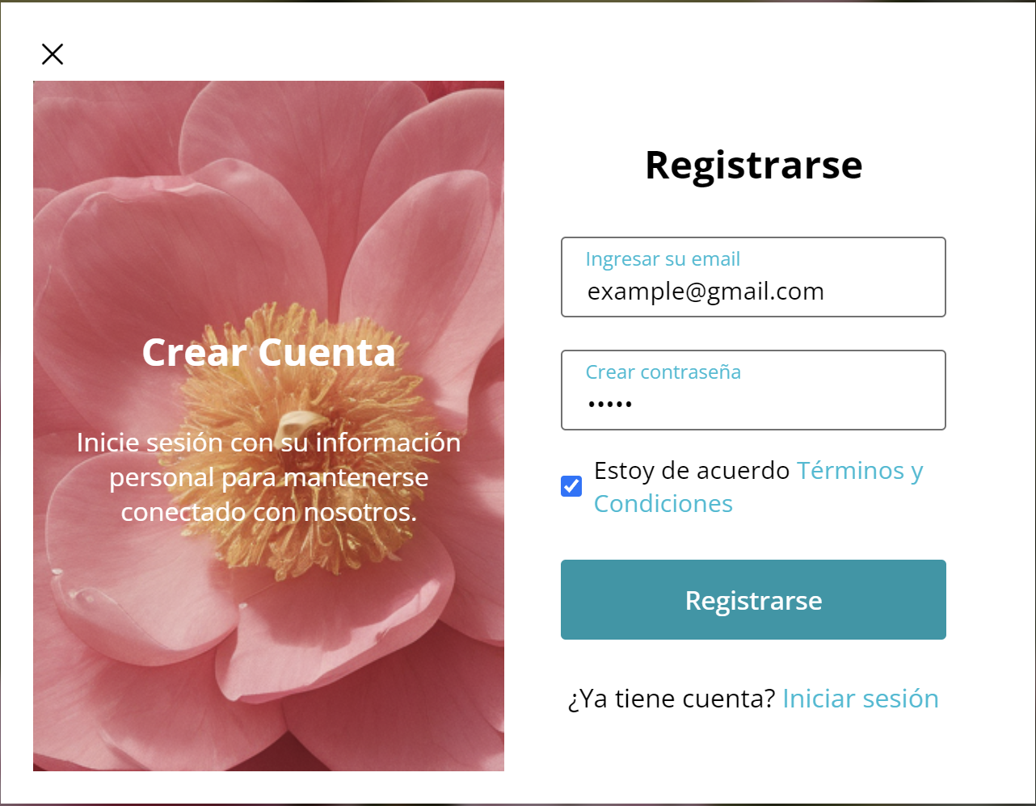
REGISTER EXAMPLE

Slide 7

REGISTER REJECT

Slide 8
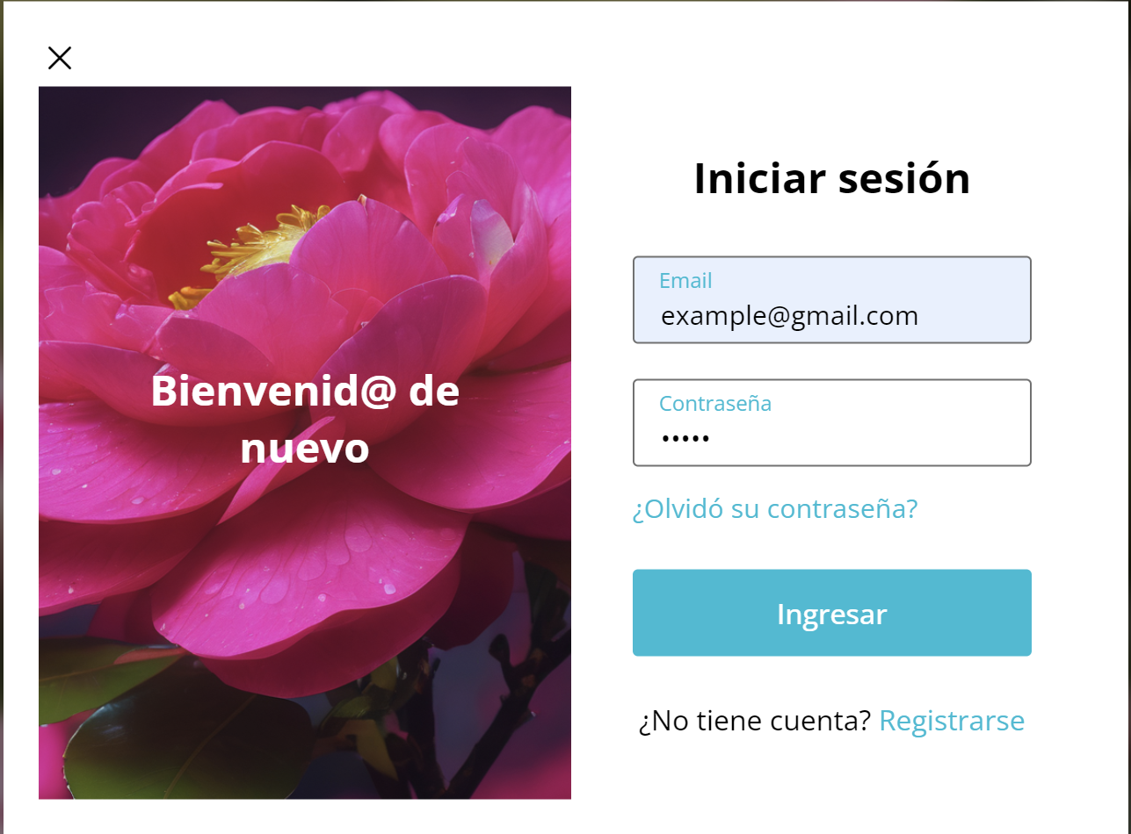

LOGIN REJECT

Slide 9
LOGIN EXAMPLE

Slide 10
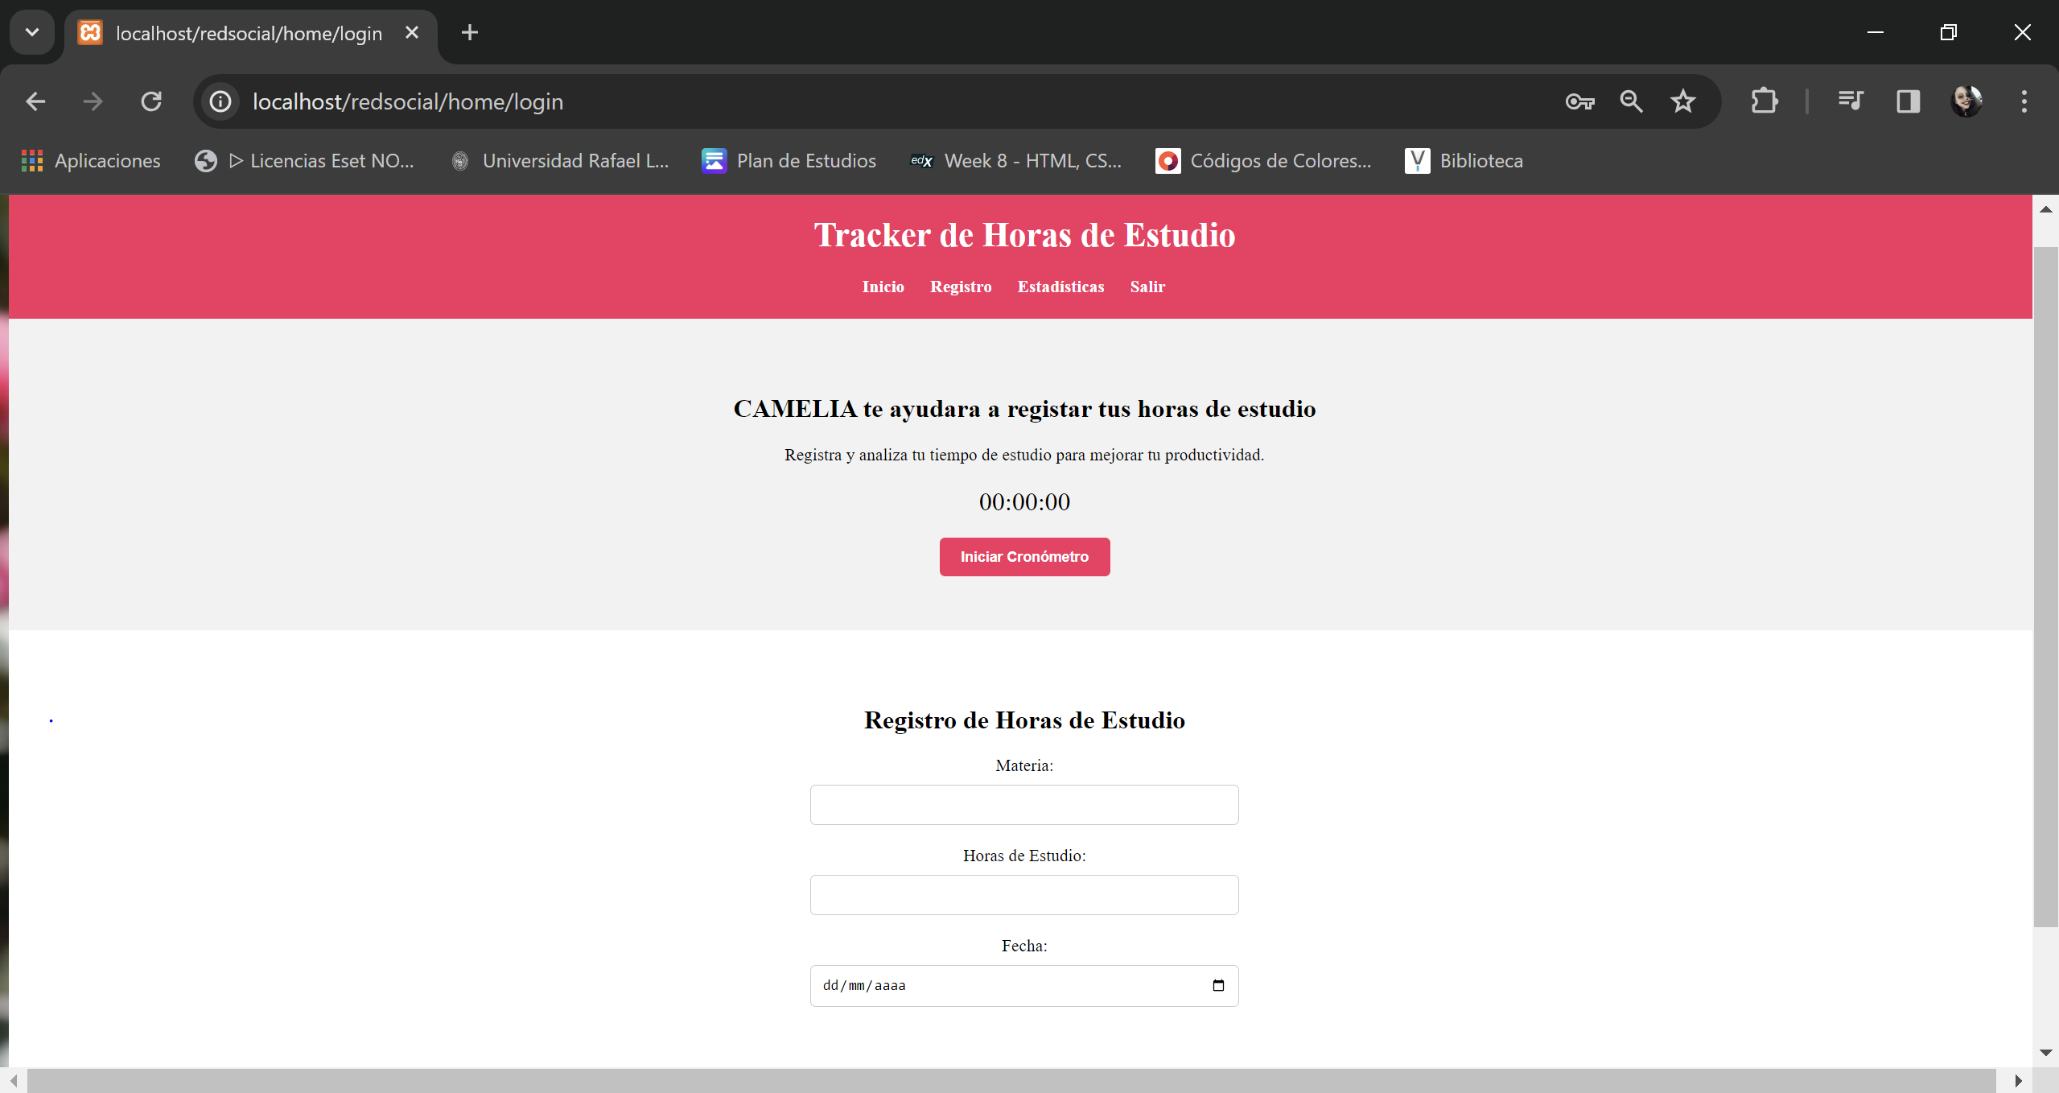
HOMEPAGE

Slide 11
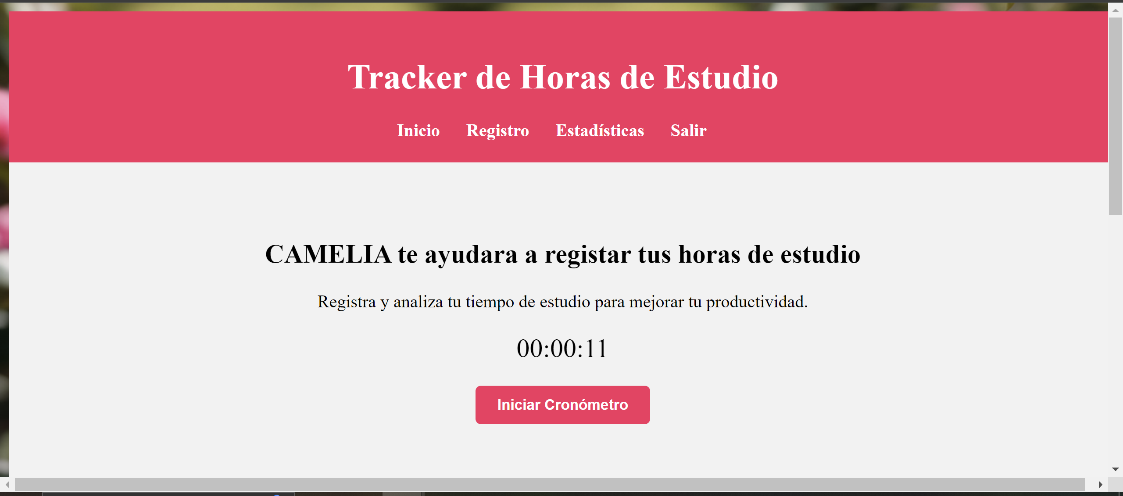

Slide 12
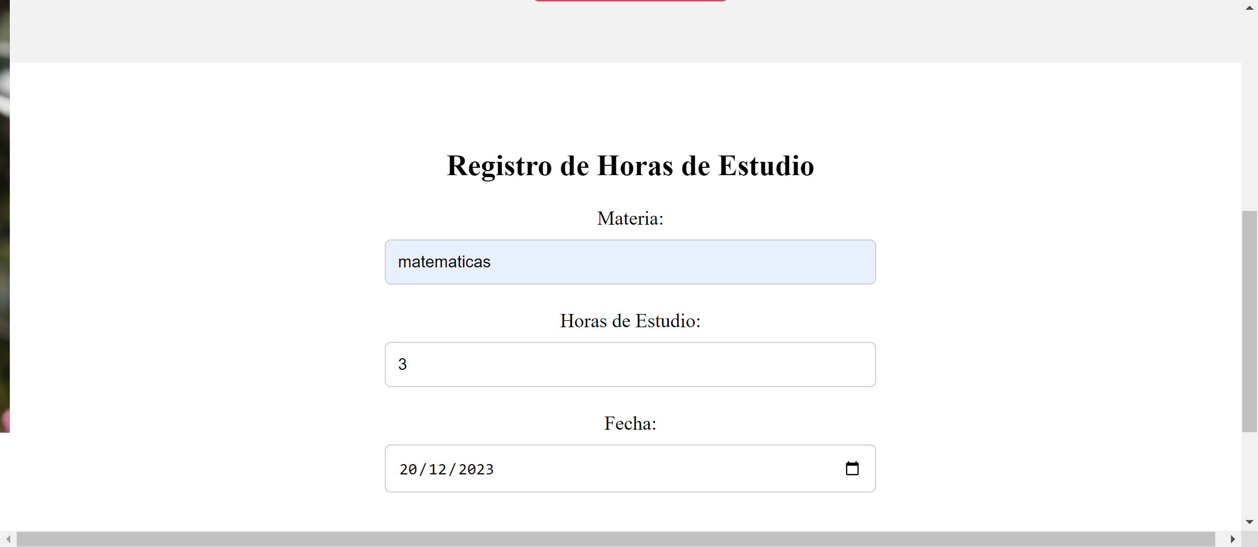

Slide 13
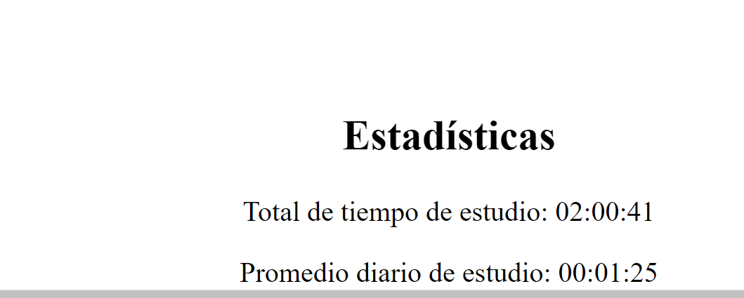

Slide 14
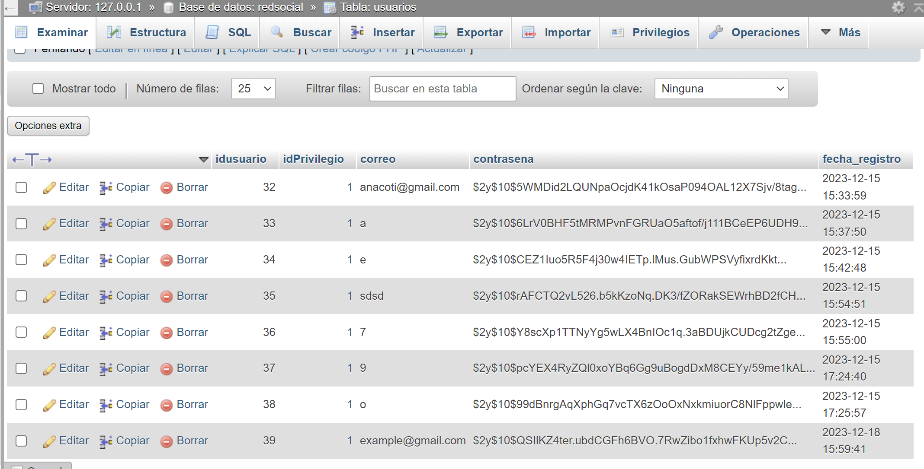
DATABASE

Slide 15
GITHUB REPOSITORY
https://github.com/Massy100/CAMELIA

